Slide 1
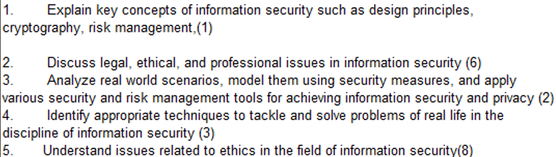
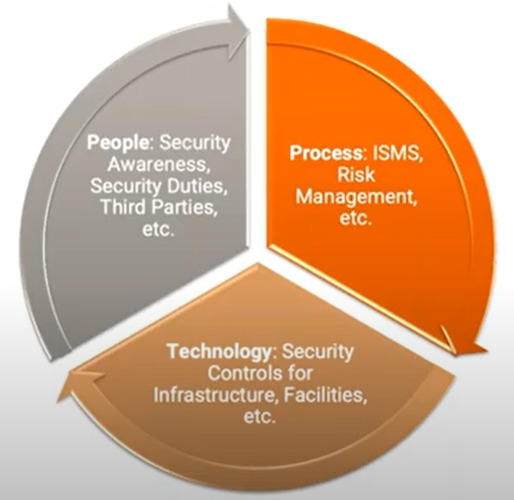
CS 3002 Information Security
Fall 2023
Week # 7 – Lecture # 17, 18, 19
Dr. Aqsa Aslam

Slide 2
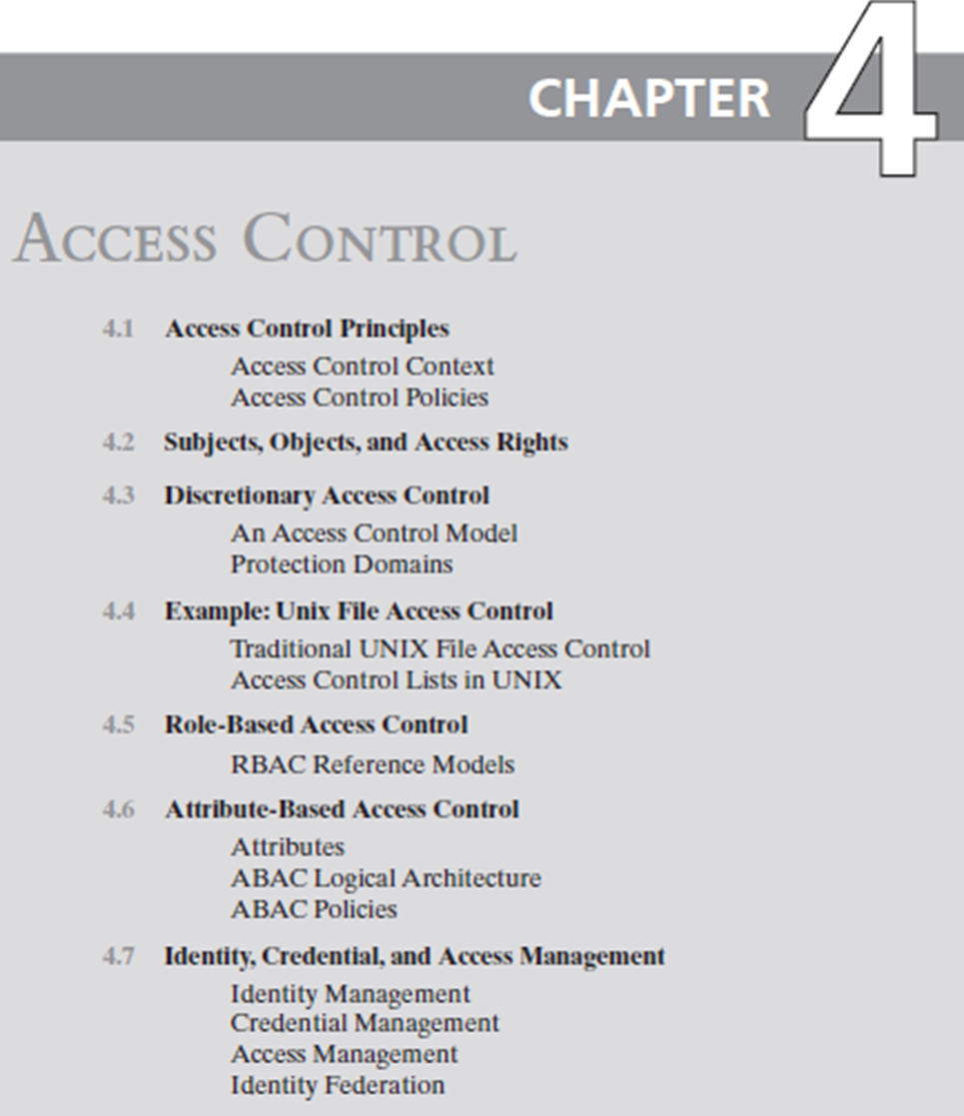
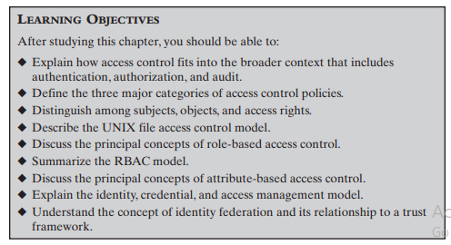

Slide 3
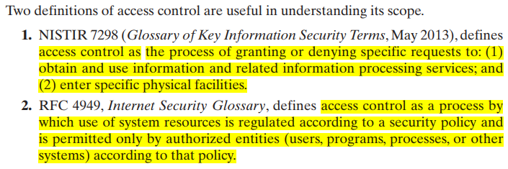

Slide 4
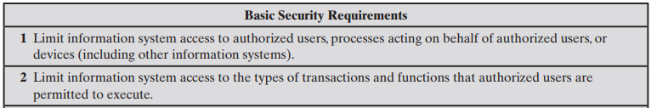

Slide 5
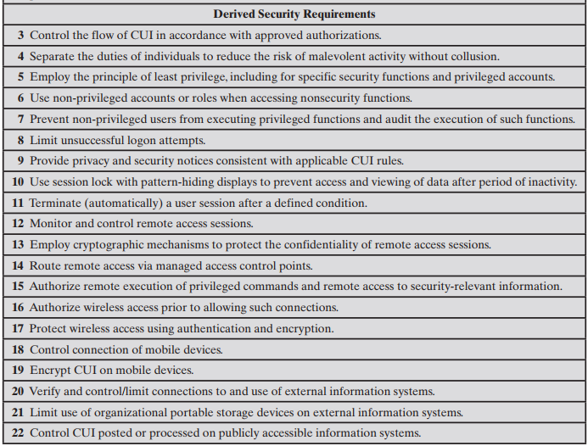
CUI = controlled unclassified information

Slide 6
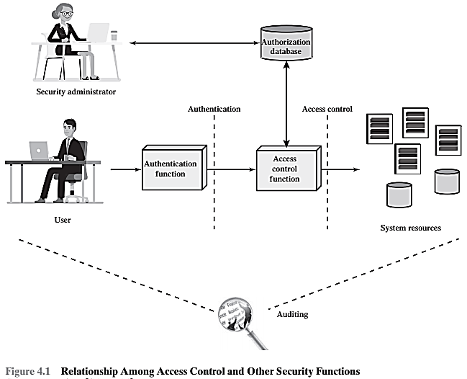
An access control mechanism mediates between
a user (or a process executing on behalf of a user) and system resources
such as applications, operating systems, firewalls, routers, files, and databases

Slide 7
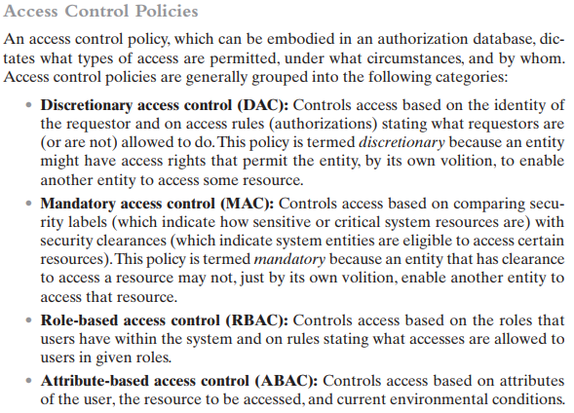

Slide 8
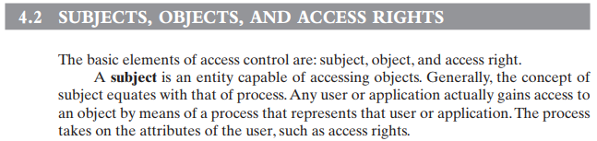
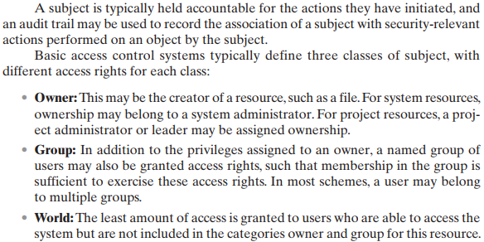

Slide 9
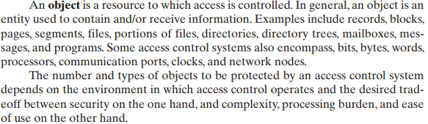

Slide 10
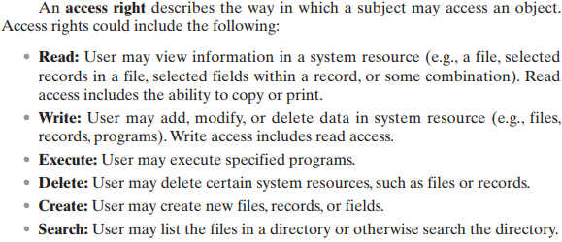

Slide 11
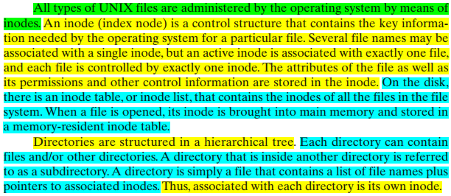

Notes:
$ ls -i /etc/passwd
Output: 752010 /etc/passwd

Slide 12
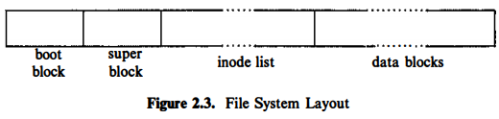
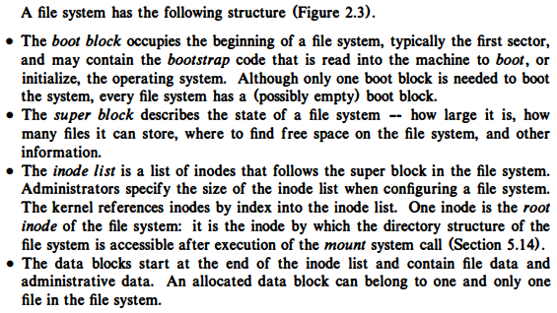

Slide 13
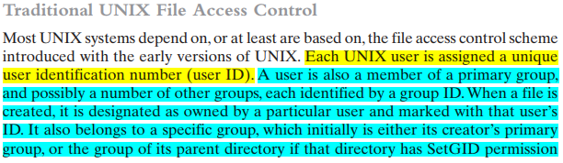
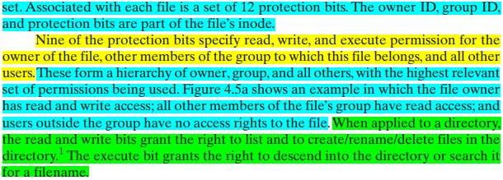

Slide 14
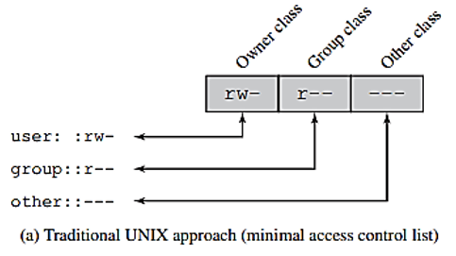

Note that the permissions that apply to a directory are distinct from those that apply to any file or directory it contains. The fact that a user has the right to write to the directory does not give the user the right to write to a file in that directory. That is governed by the permissions of the specific file. The user would, however, have the right to rename the file.

Slide 15
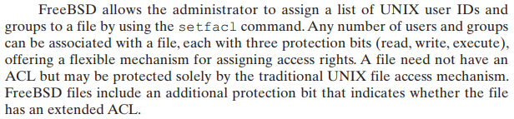
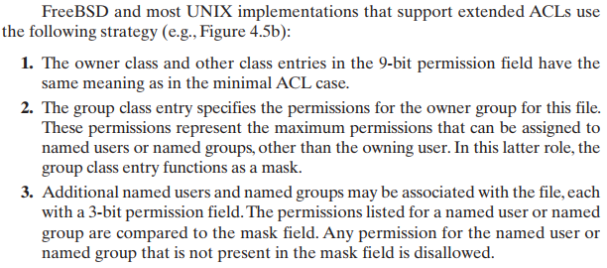
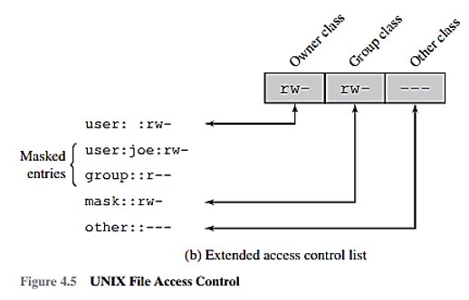
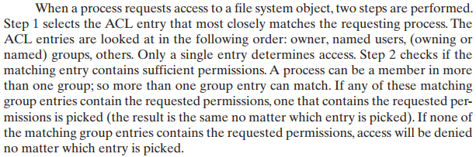
The user: :rw entry corresponds to the owner (you) and grants read, write permissions.
user: Joe:rw- specifies that Joe has read and write permissions.
group::r-- indicates that the group (the primary group of the directory) has read only permissions.
mask::rw- represents a mask that restricts permissions. In this case, it allows the maximum permissions specified in the ACL entries.
other::--- means that others (users who are not the owner or in the group) have no access.

Slide 16
Role Based Access Control (RBAC)
Definition
RBAC block diagram
RBAC₀ – Base Model
RBAC supports three well-known security principles.
Case Study: RBAC for a Bank
Attribute Based Access Control
Definition
ABAC Logical Architecture
Three Key attributes of ABAC Model
ABAC Policy Model
Online Entertainment Store Scenario
Specifying a RBAC Model
Specifying a ABAC Model
Comparing RBAC and ABAC models for the scenario

Slide 17
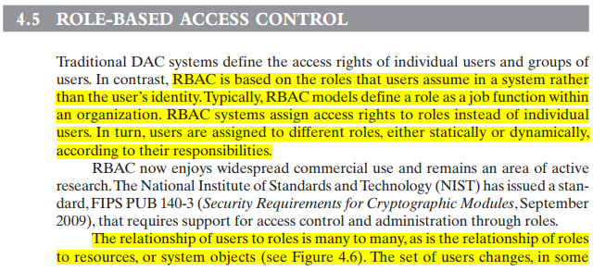


Slide 18
What is RBAC?
Role-Based Access Control Model is a nondiscretionary access control mechanism which allows & prompts the central administration of an organization specific security policy
Permission to perform an operation on an object is assigned to roles, not to users
Users are assigned to roles
Users acquire their permissions based on the roles they are assigned

Slide 19






Basic RBAC Illustrated
Users
Roles
Permissions (Objects)
Relations:
Role 1
User
Assignment (UA)
Role 2
Permission Assignment (PA)
Role 3

Slide 20
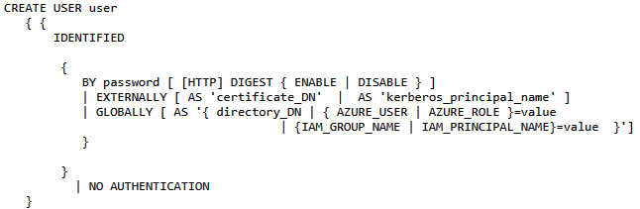
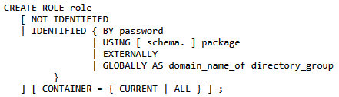

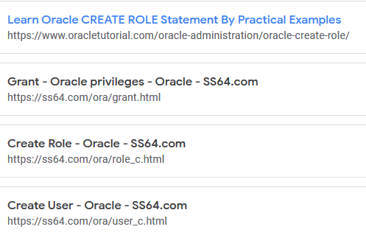
See Week # 7 materials for these links

Slide 21
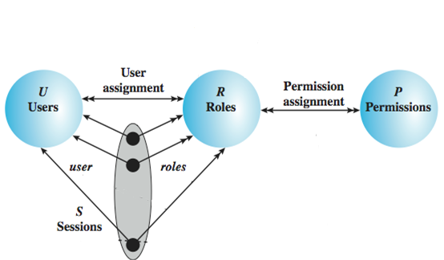
RBAC₀ – Base Model
Users: individuals with access to the system
Role: named job function within the org
Permission: approval of a particular mode of access to objects
Session: mapping between a user and a subset of roles
Notes:
Session example: UAC in Windows

Slide 22
Role-Based Access Control
RBAC supports three well-known security principles:
Least Privilege
Separation of duties
Data Abstraction
Least Privilege says that only minimum necessary rights should be assigned to a subject that requests access to a resource.
Separation of duties is achieved by ensuring that mutually exclusive roles must be invoked to complete a sensitive task.
Data abstraction is supported by means of abstract permissions such as credit and debit for an account.
The degree to which data abstraction is supported will be determined by the implementation details

Slide 23
Advantage of RBAC
Once implemented RBAC simplifies system administration
Strong support for separation of duties
Good auditing support
Considered best practice by many

Slide 24
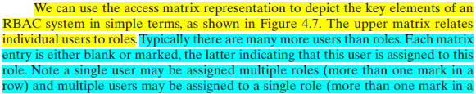

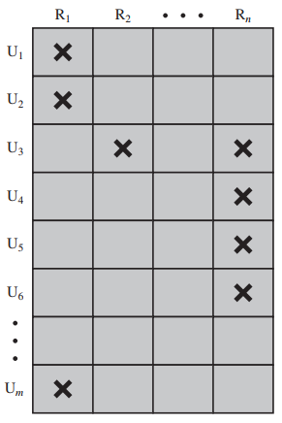
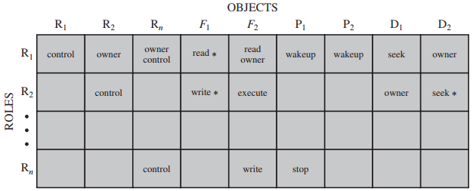
Each role should contain the minimum set of access rights needed for that role. A user is assigned to a role that enables him or her to perform only what is required for that role. Multiple users assigned to the same role enjoy the same minimal set of access rights.

Slide 25
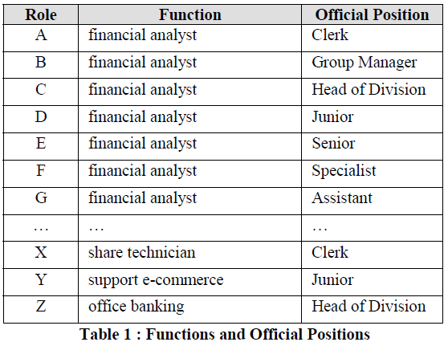
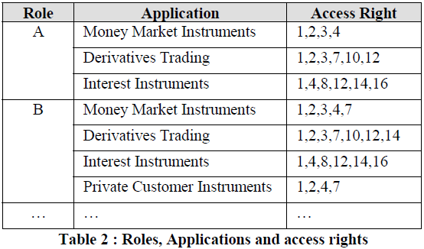
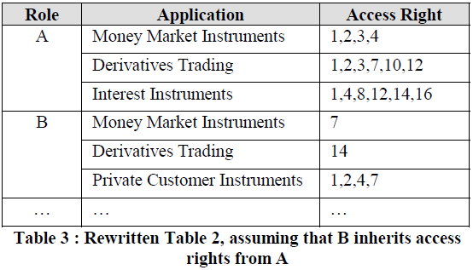
Case Study: RBAC for a Bank

Slide 26
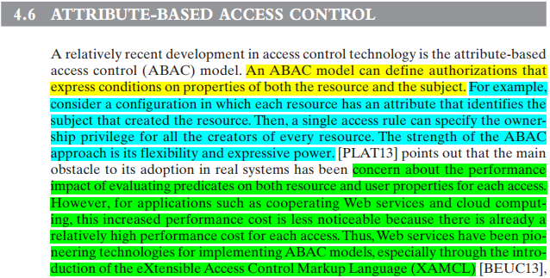
(ABAC)

Slide 27
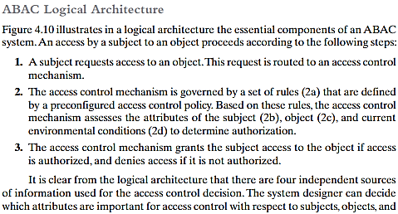
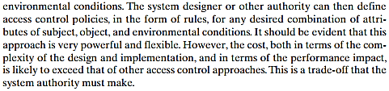

Slide 28
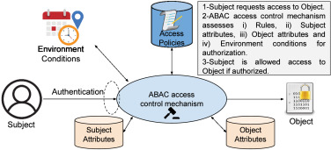
There are three key elements to an ABAC model: attributes, which are defined for entities in a configuration; a policy model, which defines the ABAC policies; and the architecture model, which applies to policies that enforce access control.
https://www.sciencedirect.com/science/article/pii/S0167739X22000115

Slide 29
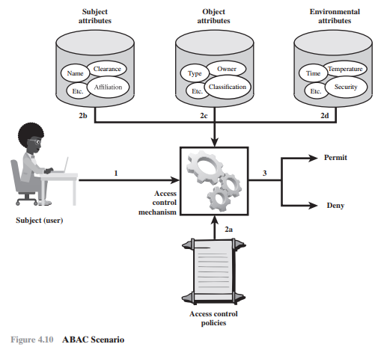
ABAC is a logical access control model that is distinguishable because it controls access to objects by evaluating rules against the attributes of entities (subject and object), operations, and the environment relevant to a request.
ABAC relies upon the evaluation of attributes of the subject, attributes of the object, and a formal relationship or access control rule defining the allowable operations for subject object attribute combinations in a given environment.
All ABAC solutions contain these basic core capabilities to evaluate attributes and enforce rules or relationships between those attributes.

Slide 30
ABAC Model
ABAC enables fine-grained access control, which allows for a higher number of discrete inputs into an access control decision, providing a bigger set of possible combinations of those variables to reflect a larger and more definitive set of possible rules, policies, or restrictions on access.
ABAC allows an unlimited number of attributes to be combined to satisfy any access control rule.
ABAC systems can be implemented to satisfy a wide array of requirements from basic access control lists through advanced expressive policy models that fully leverage the flexibility of ABAC.
ABAC systems are capable of enforcing DAC, RBAC, and MAC concepts.

Slide 31
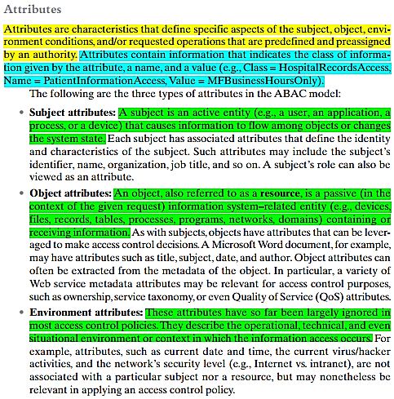
There are three key elements to an ABAC model:
attributes, which are defined for entities in a configuration;
a policy model, which defines the ABAC policies; and the
architecture model, which applies to policies that enforce access control.

Slide 32
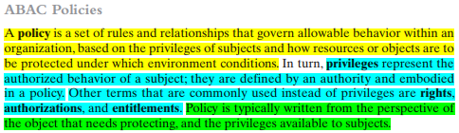

Slide 33


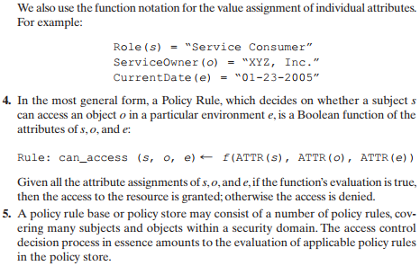
These attributes can include things like user roles, user IDs, age, group
Objects can be files, data records, resources, or anything

Slide 34
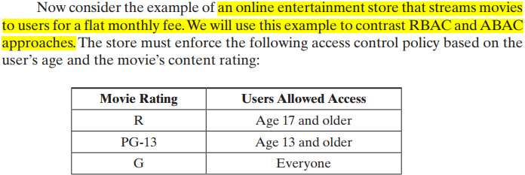
Online Entertainment Store Scenario (RBAC vs ABAC)

Slide 35
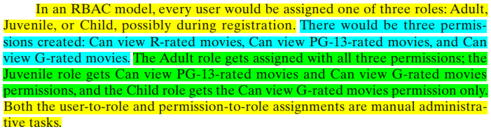
Online Entertainment Store Scenario (RBAC)

Slide 36



Online Entertainment Store Scenario (ABAC)

Slide 37

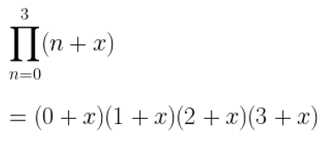
Online Entertainment Store Scenario (RBAC vs ABAC)
Question. Suppose movies are classified as either New Release or Old Release, based on release date compared to the current date, and users are classified as Premium User and Regular User, based on the fee they pay. Question: To enforce a policy that only premium users can view new movies, show RBAC and ABAC solutions.
RBAC model: we would have to double the number of roles, to distinguish each user by age and fee, and we would have to double the number of separate permissions as well. In general, if there are K subject attributes and M object attributes, and if for each attribute, Range() denotes the range of possible values it can take, then the respective number of roles and permissions required for an RBAC model are:
Thus, we can see that as the number of attributes increases to accommodate finer-grained policies, the number of roles and permissions grows exponentially.

Slide 38

Online Entertainment Store Scenario (RBAC vs ABAC)
ABAC model: deals with additional attributes in an efficient way. For this example, the policy R1 defined previously still applies. We need two new rules:
We can also add environmental attributes as follows:
Suppose we wish to add a new policy rule that is expressed in words as follows: Regular users are allowed to view new releases in promotional periods. we only need to add a conjunctive (AND) rule that checks to see the environmental attribute today’s date falls in a promotional period.
This would be difficult to express in an RBAC model.

